Slide 1
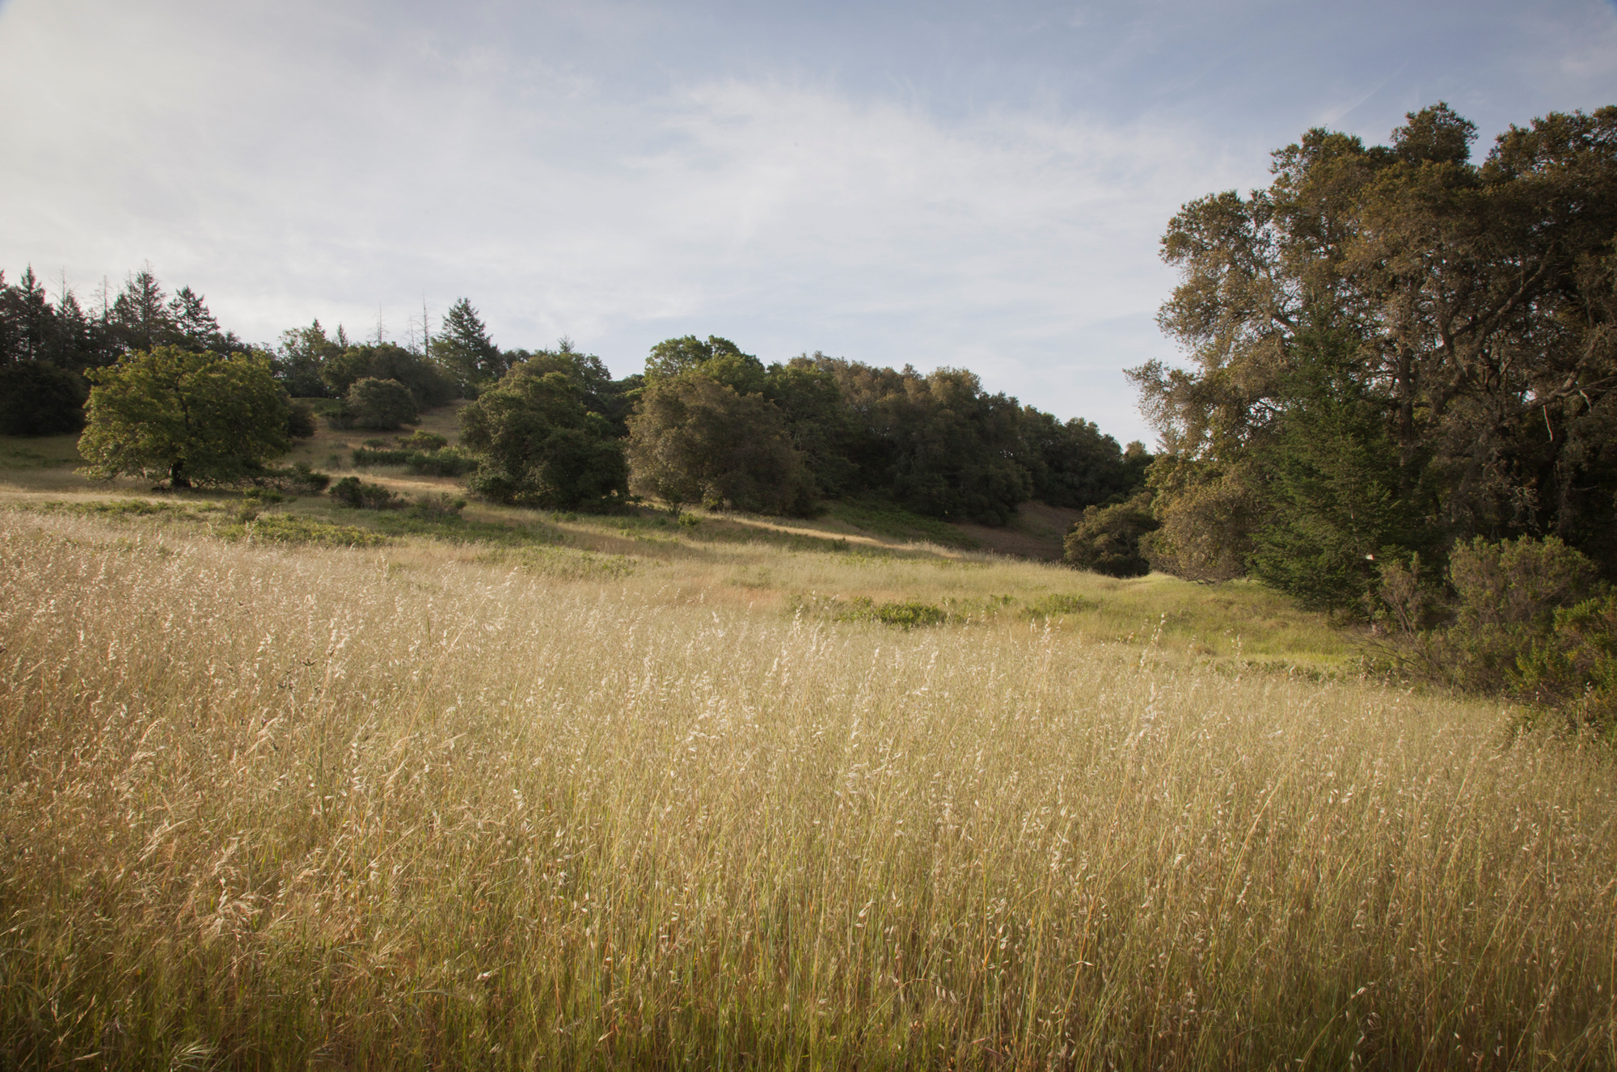
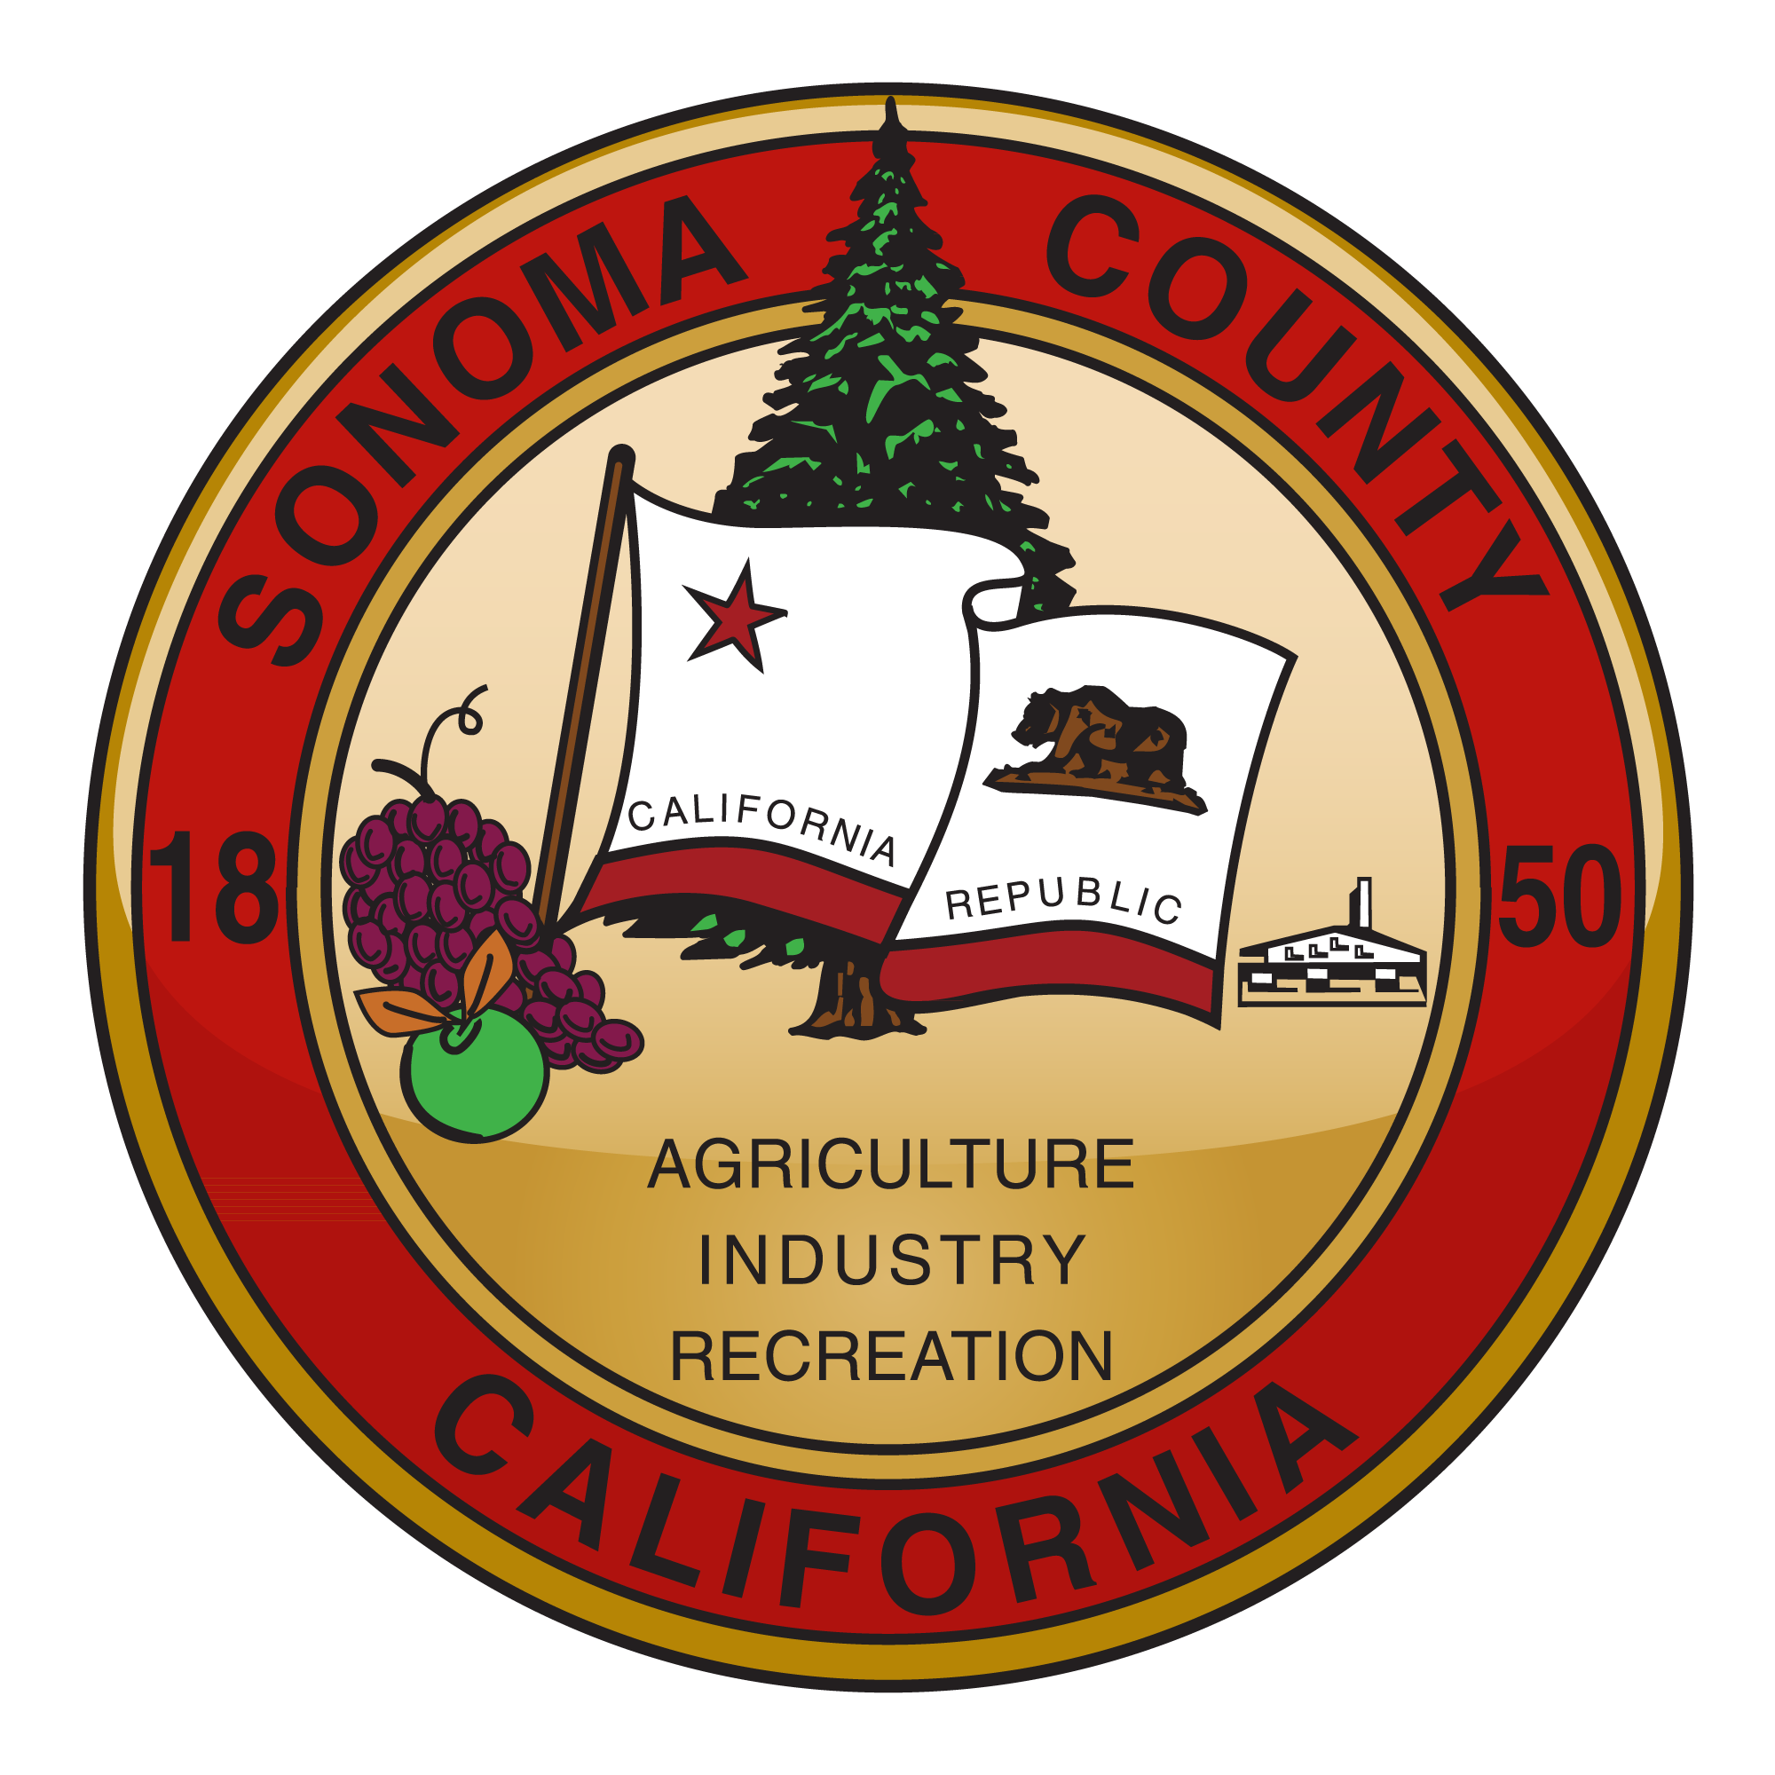
Community Outreach Meeting -
Vegetation Management & Wildfire Resilience in Sonoma County
October 26, 2022
Healthy Forests Ad Hoc Committee

Slide 2
Focal Points
Healthy Forests Ad Hoc Member Objectives
Summary of CLEE Report Action Items
Update on Thematic Areas
Prioritization of Treatments
Wildfire Resilience Planner tool
CWPP Project Prioritization Process
Vision and coordination for County departments and organizations
“House Out – Landscape In” priority treatment areas
Workforce Development / Capacity Building

Slide 3
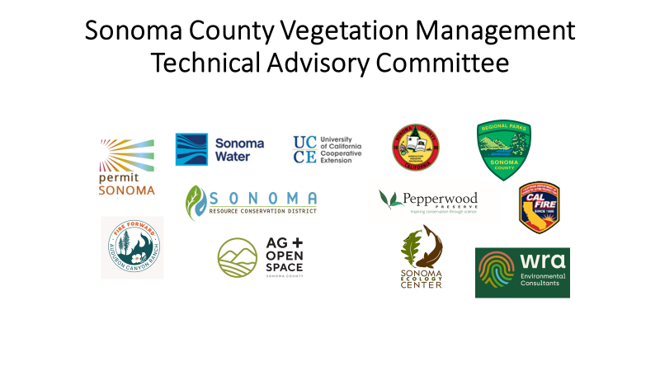
Tac
Notes:
Partners with vast experience / CALFIRE state jurisdiction and fire and forest management expertise / Pepperwood staff with research and practical experience of managing 2000 acre preserve / RCDs and our NGO partners have worked extensively with landowners on forest management planning, Rx grazing, Rx burns, shaded fuel breaks. Our County agencies manage over 16,000 acres and oversee easements over 115,000 acres, environmental compliance, water quantity and water quality.

Slide 4
Accomplishments/Progress
46 Vegetation Management Grant projects - $8.3M + $1.1M match
Defensible space assessments in 10 of 14 pilot communities
7 regional collaborations
Private sector / public sector collaboration
11 CAL VTPs completed or in process
25+ community workshops / webinars / field events
Data – Data – Data
Wildfire Resilience certificate program (SRJC) / 350 Basic Wildland Firefighters (Fire Forward) / 185 prescribed burns since 2017

Slide 5
A LANDSCAPE SCALE APPROACH TO WHOLE COMMUNITY FIRE RESILIENCY
CONTINUUM OF RESILIENCY ACTIONS (“DEFENSE IN DEPTH”)
PREVENTION
Weather prediction / warnings / watch for severe fire conditions, Reduce human ignition sources
VEGETATION MANAGEMENT
Install and maintain “Landscape-In” (near community) or landscape scale vegetation management features for whole community protection and/or ecosystem health (forest, woodland, grassland, chaparral)
DEFENSIBLE SPACE
“House outward”: Require, encourage and enforce for new and existing infrastructure (0-5’/5’-30’/30’-100’ zones)
STRUCTURAL DEFENSES
“House Outward”: New construction, retrofit existing structures, ember cast protection
FIRE RESPONSE
Rapid response and control, adequate resources, efficient command and control
EARLY WARNING, EVACUATION
Citizen warnings and orders on multiple platforms, evacuation plans and procedures, etc.
Progress: extensive network of fire cameras, improved fire weather prediction, undergrounding powerlines, depowering lines, etc.
Progress: Implementation of veg mgmt grants program, HMGP grants, advancing “whole community” approach (BRIC), increased use of prescribed fire, improved coordination (TAC, ad hoc planning), etc.
Progress: Increased voluntary assessment and code inspections, HMGP cost-share program development, chipper programs, etc.
Progress: Structural assessments and cost-share program with FEMA grants, coordination with insurance industry, incorporating best science
Progress: Consolidation and funding of local fire districts, improved communication and coordination, DEM formation, Los Guillicos camp, etc.
Progress: Improved citizen communication system, improved inter- and intra-agency coordination, planning (MJHMP, CWPP), evacuation route development in public safety element
Determining and Measuring “success”: Monitoring, Modeling, Cultural Change, Quantitative Criteria, Adaptive Management
Ecological success measures
vegetation, fuel loads, ecosystem health
Quantitative data: vegetation, indicator wildlife, meteorological, climate, soil moisture, hydrology, carbon
Adaptive management
and predictive modeling:
fire, climate, drought, flooding, etc.
Cultural and personal attitudes, perception, behavior change
Structural success measures:
defensible space participation,
structures hardened, community plans adopted, etc.

Slide 6
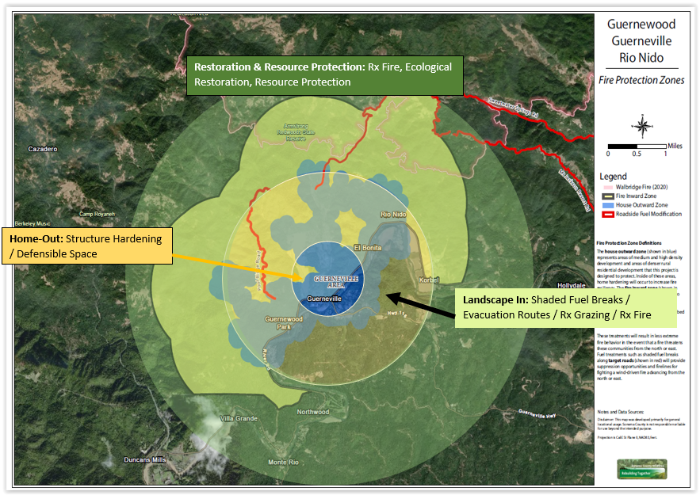
Conceptual View of Vegetation Mgt & Wildfire Resilience

Slide 7
Initial Recommendations
Immediate Vegetation Management Activities
Provide funding to community-based projects to increase resilience in high-risk zones in advance of the 2021 and 2022 fire seasons, with priority for shovel-ready projects, local organizations with track records of success, multi-benefit work, and other criteria.
Recommendations:
Provide funding for prioritized fuel management projects using enhanced selection process, criteria, and use of prioritization tools under the CWPP Project Entry Tool and Wildfire Resilience Planner.
Implement a pilot project to support Technical Assistance Grant funding to 3-5 projects representing a variety of conditions and geographic focus.
Notes:
Future funding cycles will not be reactive to proposals but will intentionally strive to meet the landscape level approach. Request for Proposals will focus on specific asks and outcomes expected. Coupled with the CWPP will help to fill the gap between good intentions and successful projects that prioritizing treatments.

Slide 8
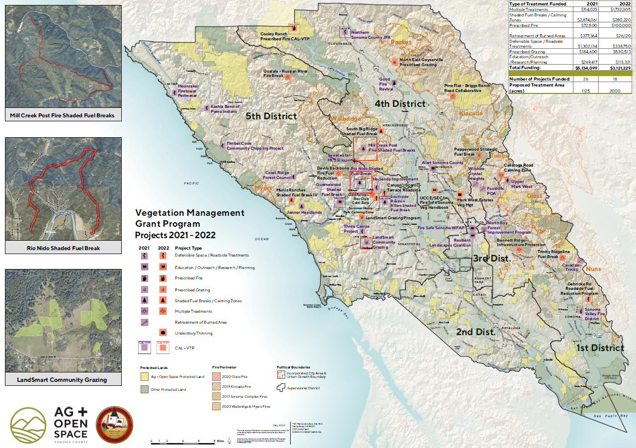
Map

Slide 9
Questions & Comments
Vegetation Management Grants / Implementation
Specific to selection criteria and technical assistance?
Monitoring efforts?

Slide 10
Initial Recommendations
Outreach and Education
Outreach and education capacity to spearhead communication with landowners, businesses, and residents on actions private individuals can take to reduce fire risk, including dollars specifically allocated for bilingual and equity-focused outreach.
Recommendations
Provide a County website/portal for landowners and resource managers highlighting grant programs, technical assistance providers, best management practices, and other resources available through the County and partners.
Offer training and outreach programs to build community capacity in project development, CEQA, technical scopes of work for vegetation management pre-grant Request for Proposal.
Provide funding to support Sonoma County Forest Conservation Working Group coordination (Gold Ridge RCD) and Fire Safe Sonoma.
Support Living with Fire: Sonoma County Forest Management Conference. (So. Co. Forest Conservation Working Group and UC Cooperative Extension)

Slide 11
Initial Recommendations
Data, Prioritization, Planning and Mapping
Collect and analyze best available data, mapping, and planning efforts that expand on the County’s Community Wildfire Protection Plan and other key data-collection initiatives to inform smart decision-making throughout the county.
Recommendations:
Complete LiDAR update and reevaluate and analyze change in vegetation trends.
SONOMA WATER / UCCE: Use Wildfire Resilience Planner tool to assist in selecting sites and projects that meet a high level of parameters and criteria.
Sync the Sonoma County CWPP Project Entry Tool with the Wildfire Resilience Planner (WRP)
PERMIT SONOMA: Complete and approve Sonoma County CWPP and modify Project Entry Tool to include two project types: House-Out and Landscape-In.
5. Create a Technical Advisory Committee specifically for House-Out.

Slide 12
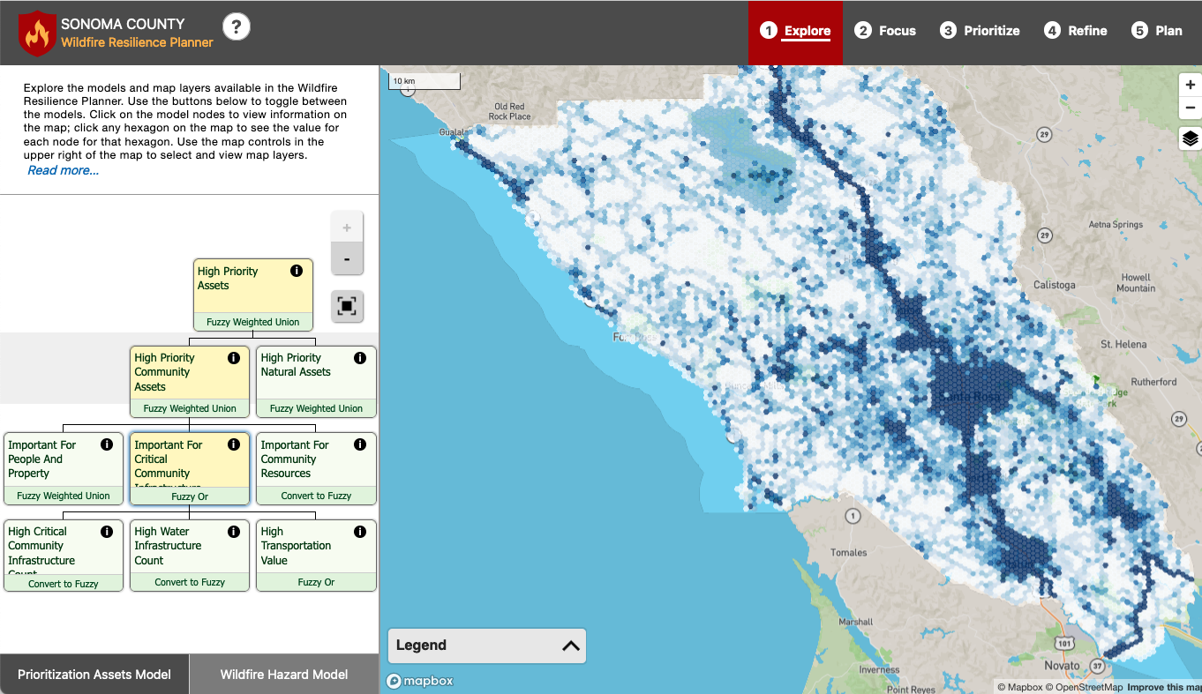
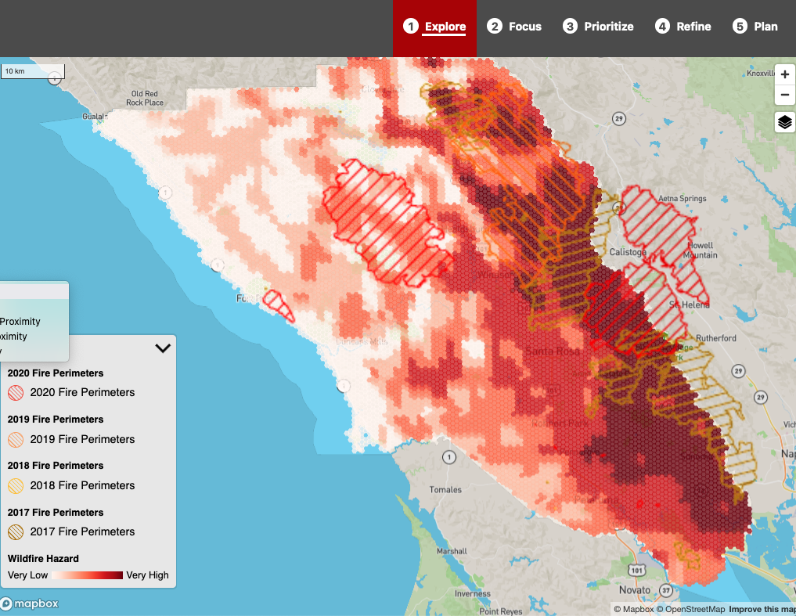
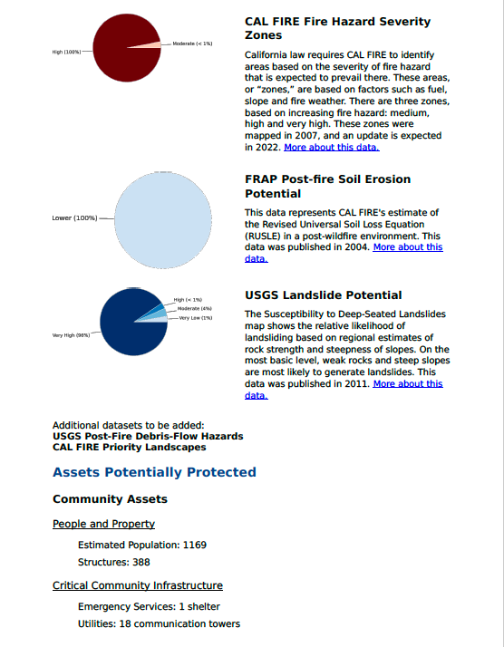
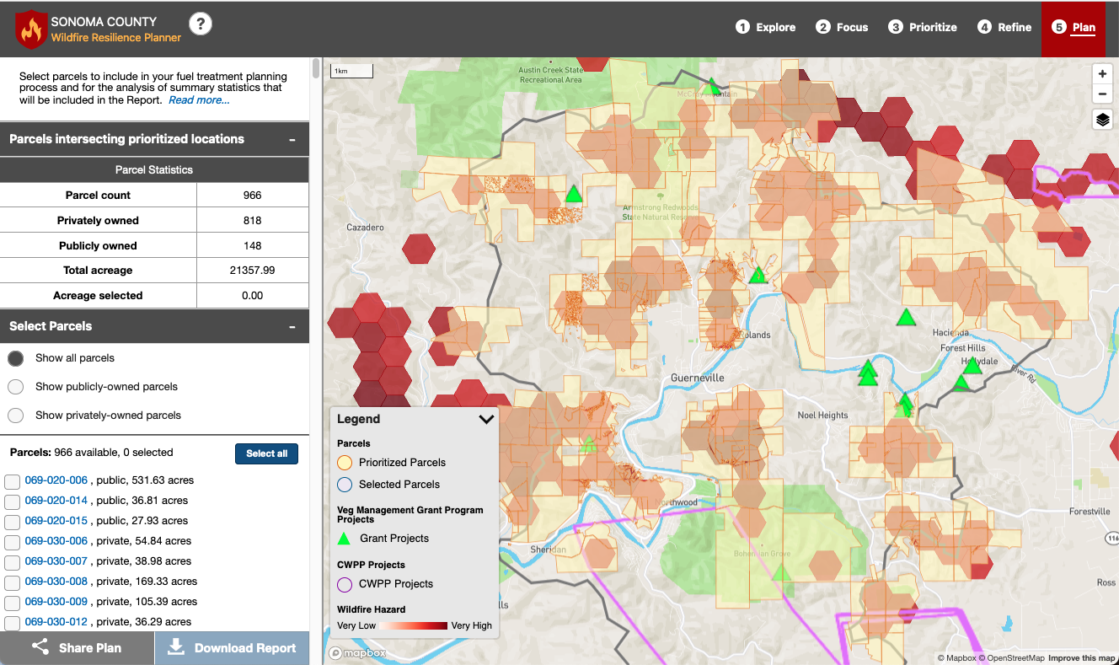
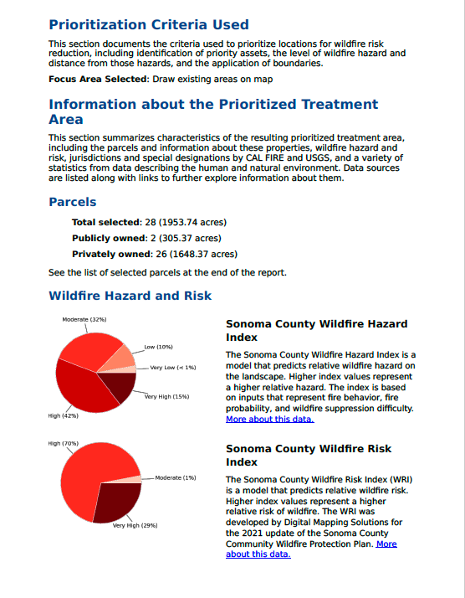
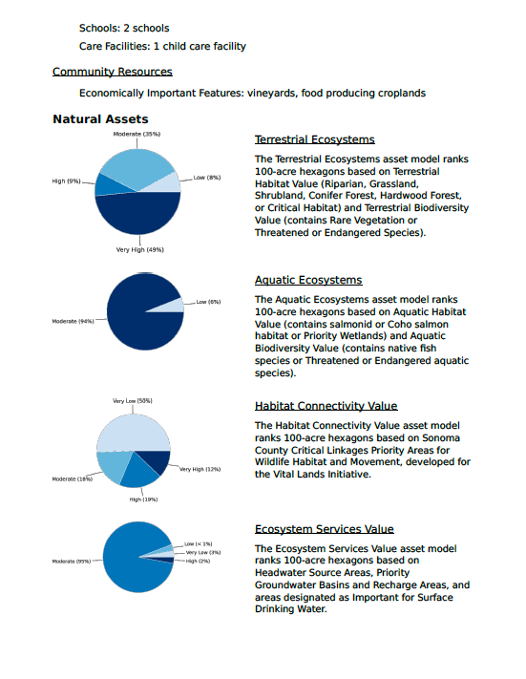
Asset Prioritization Model
Wildfire Hazard Model
(Tukman Geospatial)
Report with information about the prioritized treatment area

Slide 13
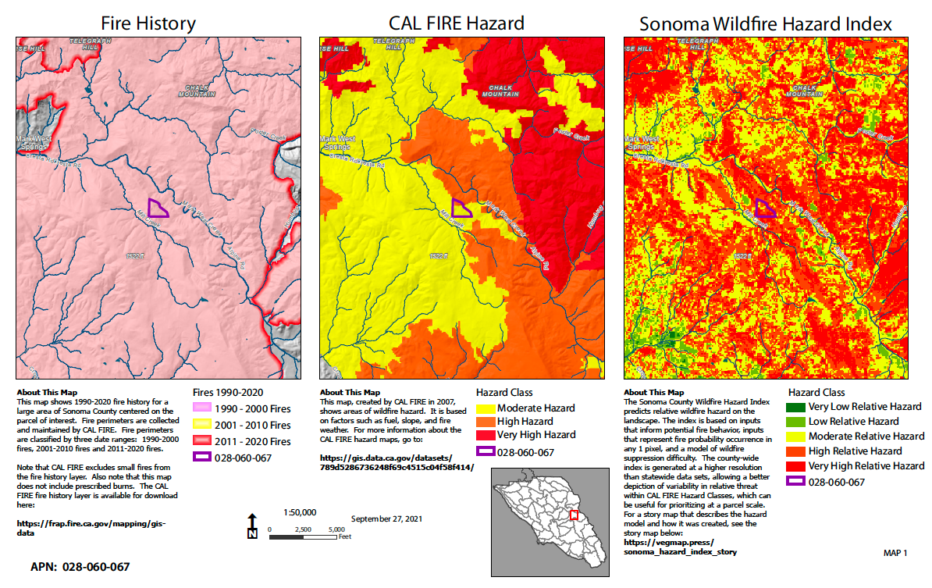
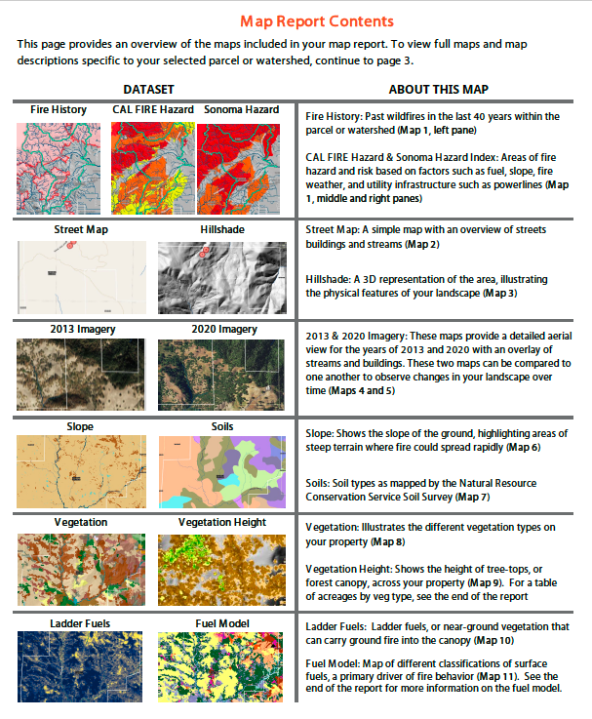
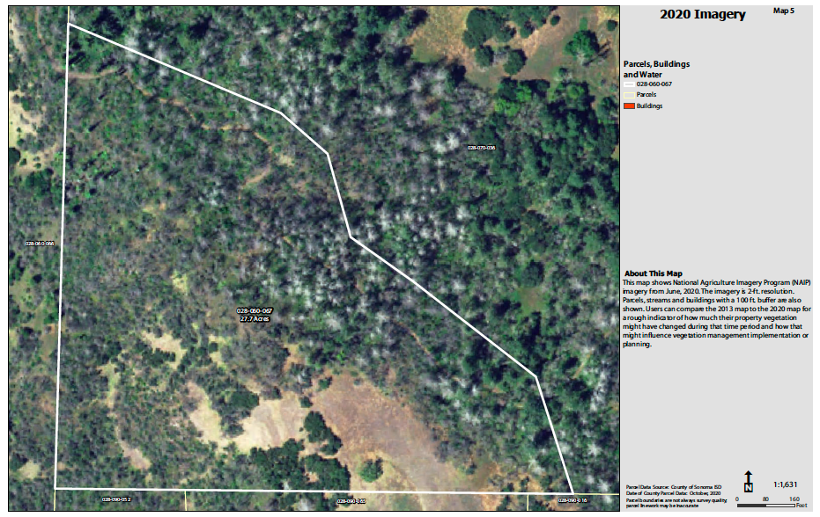
The Wildfire Fuel Mapper Maps
Notes:
The Resilience Planner links to the Fuel Mapper’s data by parcel.

Slide 14
Questions & Comments
Data, Prioritization, Planning and Mapping
When will the public have access to the Wildfire Resilience Planner tool?
Can the Fuel Mapper help me prioritize treatments on my property?

Slide 15
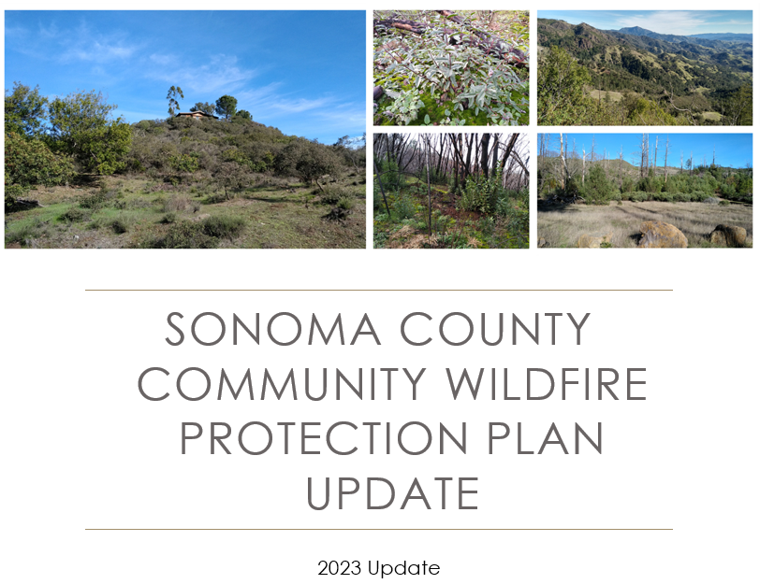


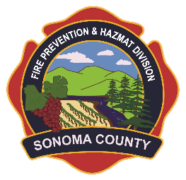


CWPp
Notes:
Update led by Permit Sonoma Fire Prevention Division with help from Fire Safe Sonoma, CAL FIRE, and our project contractor, Digital Mapping Solutions. Funded by FEMA Hazard Mitigation Grant Program, administered by Cal OES.

Slide 16
What is CWPP?
Three Minimum requirements:
Collaborative.
Identifies areas for hazardous fuel reduction and recommends types and methods of treatment.
Recommends measures to reduce the ignitability of structures.
A tool to encourage collaboration between agency and community stakeholders and to help prioritize and implement high priority projects.
A CWPP is a “living document.”
Notes:
It’s more of a PATHWAY solutions. Not regulatory. Not a funding mechanism per se, but a means to helping communities and agencies find funding for high priority projects

Slide 17
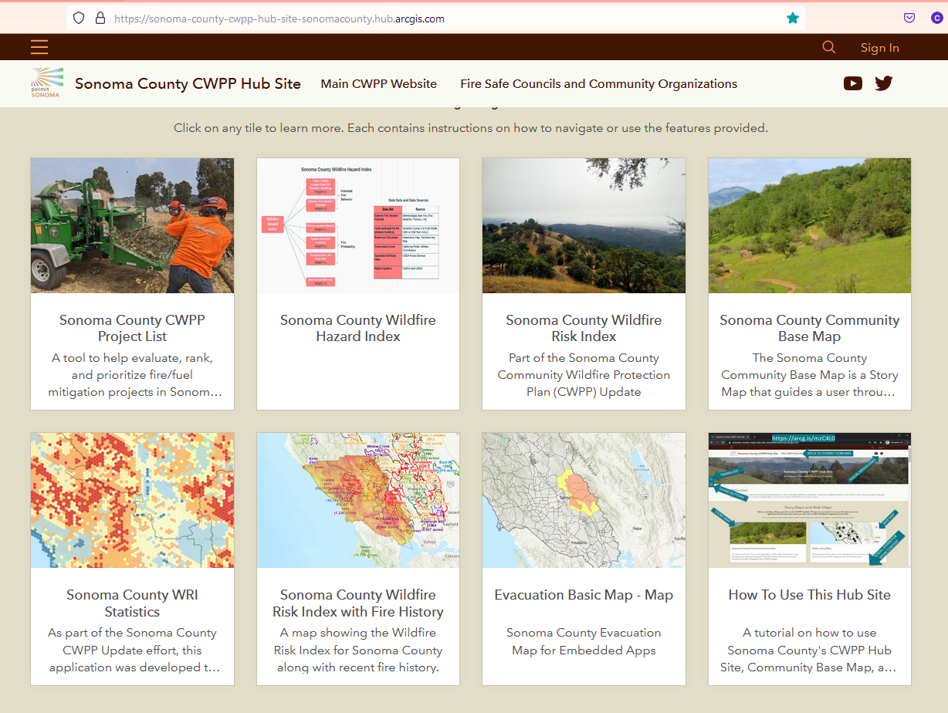
Draft One Accomplishments:
Hazard and Wildfire Risk Indices created.
CWPP Hub Site: WRI, Project Entry Tool.
Meetings in all five supervisory districts.
Draft CWPP created and reviewed.
Changes incorporated.
Second Draft Review in process.
CWPP Hub Site:
https://arcg.is/mzC4L0
CWPP Web Site:
https://permitsonoma.org/sonomacountycwpp

Slide 18
Next Steps
November 4: Internal and Steering Committee Review complete.
Public Review
November 16 - Draft posted for public review.
Public Meetings (Zoom)
November 29 from 6-7:30 PM.
November 30 from 6-7:30 PM.
Links and Updates on Web Site: https://permitsonoma.org/sonomacounty-cwpp
Pop your Email in Chat if you’d like to be added to our CWPP list
Comments incorporated, final version by December 10
Board & Signatory Acceptance February 28 (tentative)
Notes:
https://permitsonoma.org/sonomacounty-cwpp

Slide 19
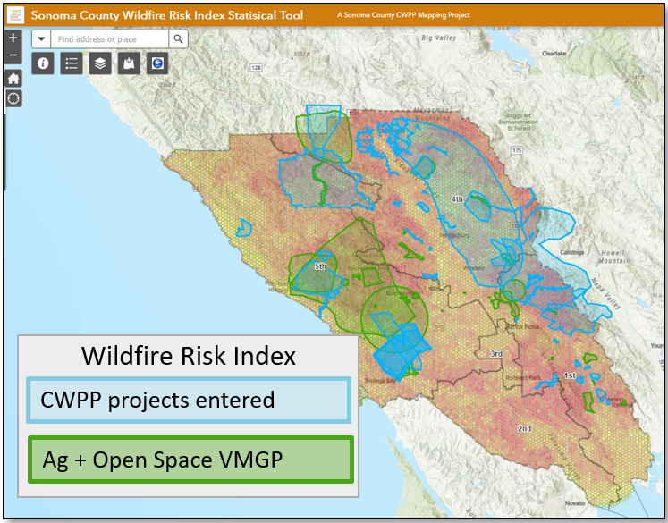
Community Wildfire Protection Plan
Recommendations:
Complete and Approve Sonoma County CWPP Update.
Finalize mapping and project prioritization strategies for county-wide overview of proposed projects.
Create collaborative ranking panel for project review.

Slide 20
Initial Recommendations
Coordination and Collaboration – A Vision
Centralizing stakeholder coordination and governance. Improve capacity to centralize county efforts, streamline permitting, gather data, and lead outreach initiatives, such as a new multi-agency working group with long-term dedicated staff.
What do organizations/departments need to best complete Vegetation Management for Wildfire Resilience?

Slide 21
Initial Recommendations
Recommendations:
Establish Technical Advisory Committees to focus on organizational structure and support long-term wildfire resilience.
Create Technical Advisory Committees for:
Organizational Structure and Funding analysis, cost estimates & County coordination
Home-hardening, defensible space (Home-Out)
Landscape-level vegetation management (Landscape-In) – ecological monitoring, restoration and enhancement pared with wildfire resilience
PERMIT SONOMA - Support Phase 1 - Planning and Project Site Identification in five designated regions under the Hazardous Fuel Management Grant program.
Test Stewardship Plan concept with RCDs to plan and prioritize regional fuel load management, fire resilience strategies, evacuation priorities, resource protection, watershed health, under a variety of different treatments.
Financially support technical collaborator to work with regionally identified collaborations / regional priorities and ongoing work.

Slide 22


People, Structures, Land Use: Reducing Risk of Wildfire Loss
Natural Resource Division
Large-scale vegetation management
House-Out
Landscape-In
Structure Hardening &
Defensible Space
Wildland Fuels Reduction
Fire Prevention Division
Defensible space and structure hardening assessment
Cost-share program with SCEIP
Notes:
We are a large agency, with a lot of varied skills and expertise.

Slide 23
Current FEMA Funding
1. Wildfire Adapted Sonoma County
Two HMGP Grants, Phase 1 completed July 2023
Reduce near-structure fuels, Harden structures, Increase the resilience of the whole community.
2. Sonoma County Hazardous Fuels Management (HMGP)
Phase 1 completed November 2023
Large-scale vegetation management projects in 4 project areas
3. Combined approach of (1) and (2): Whole community,
landscape scale wildfire resilience
BRIC Grant: Three model landscapes (Award Pending, Phase 1 – 18 mos.)
Larkfield-Wikiup/Mark West Creek
Guernewood-Guerneville-Rio Nido
Penngrove-Sonoma Mountain

Slide 24
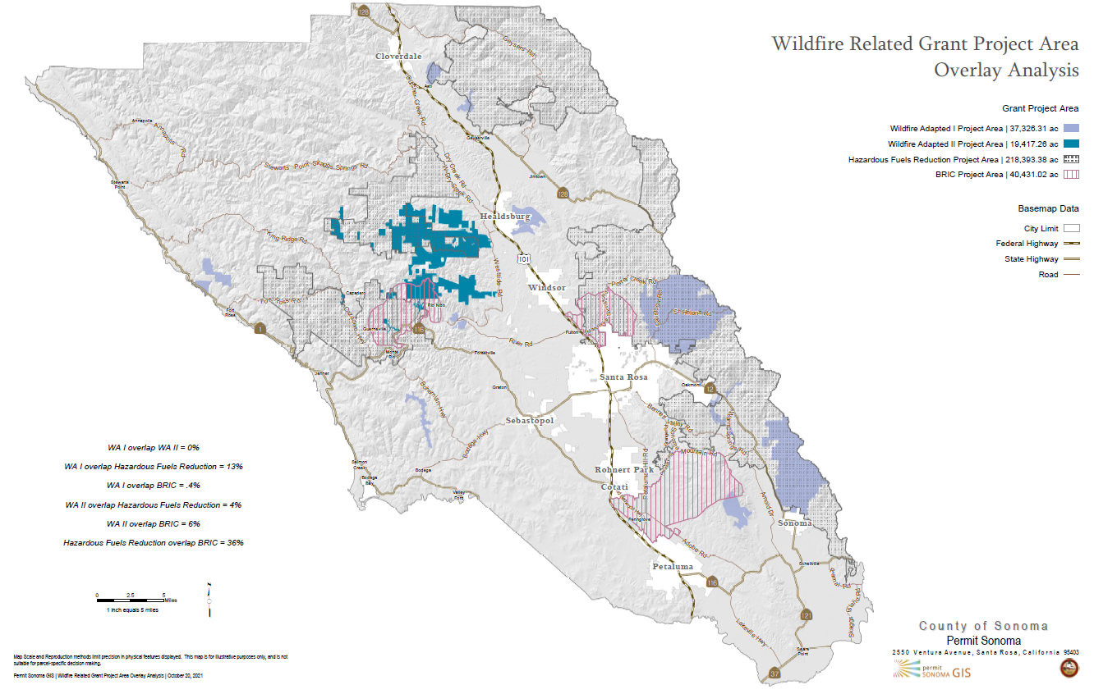


Current and Proposed Project Areas
Wildfire Adapted Part 1
Wildfire Adapted Part 2
Hazardous Fuels Reduction Project
Wildfire Resilient Sonoma County, BRIC
Wildfire Adapted Project Areas
BRIC Project Areas
Hazardous Fuels Grant Project Areas
Notes:
Sonoma County contains highly varied ecosystems from cool coastal redwood forests to chaparral. We are also quite different from Larimer County in that we have virtually NO federal land, and the vast majority of our forested areas is in small parcel private ownership.

Slide 25
Questions & Comments
FEMA Grants
How and when will be vegetation treatments be carried out?
How will I know if my parcel will be considered grant funding?

Slide 26
Initial Recommendations
Labor and Workforce Development
Invest in career training programs to launch a self-sustaining skilled and dedicated workforce equipped to meet long-term vegetation management needs. Vegetation management jobs can offer a pathway to a high-quality, well-paying, local career, provide workforce training and long-term career growth opportunities to lower-income communities and communities of color, and staff vital capacities for future resilience creating a skilled workforce.
Recommendations:
Create County fuels agency to provide permanent, well-compensated jobs and career track for workforce (ex. No. So. Co. Fire District, Sonoma Valley Fire District) to provide entry level through senior management positions to support prescribed burn and fuel load management.
FIRE FORWARD – Career Pipeline: New focus on development of demonstration career pathways for prescribed fire crew with Apprentices, Practitioners, Squad Leaders, Captains, Crew Leads, as well as all management, planning, ecology, and compliance positions that would be needed across the County dedicated to prescribed fire specifically in order to meet pace and scale.

Slide 27
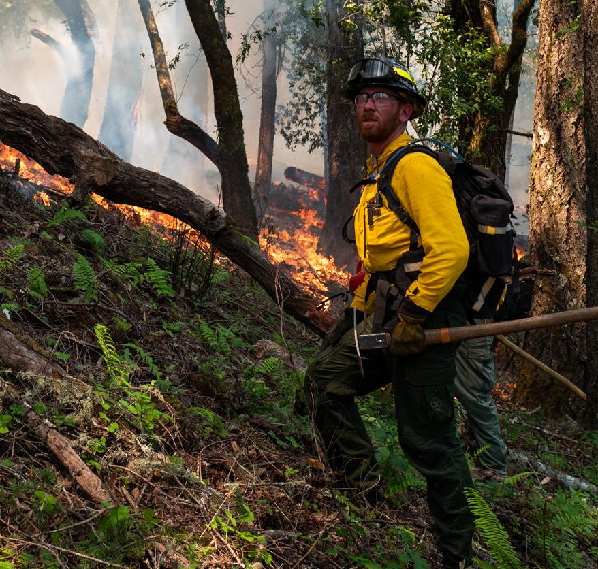
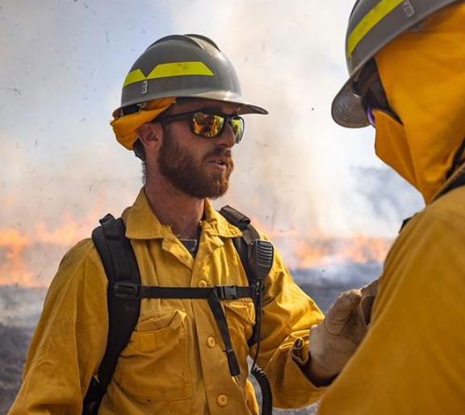
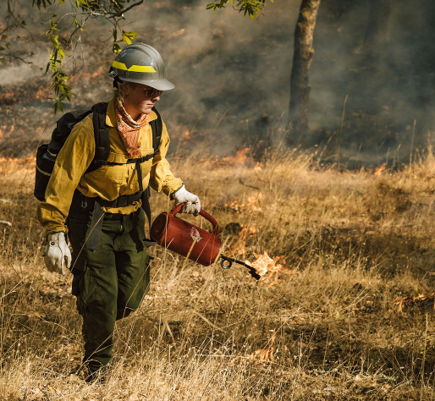
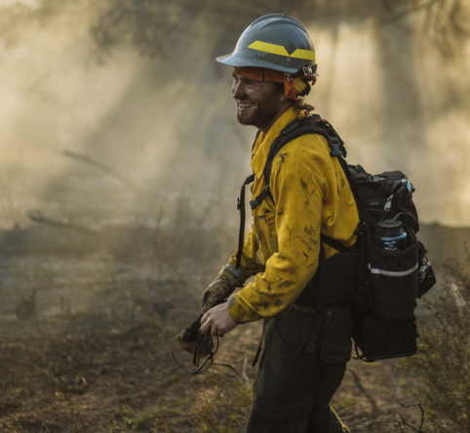
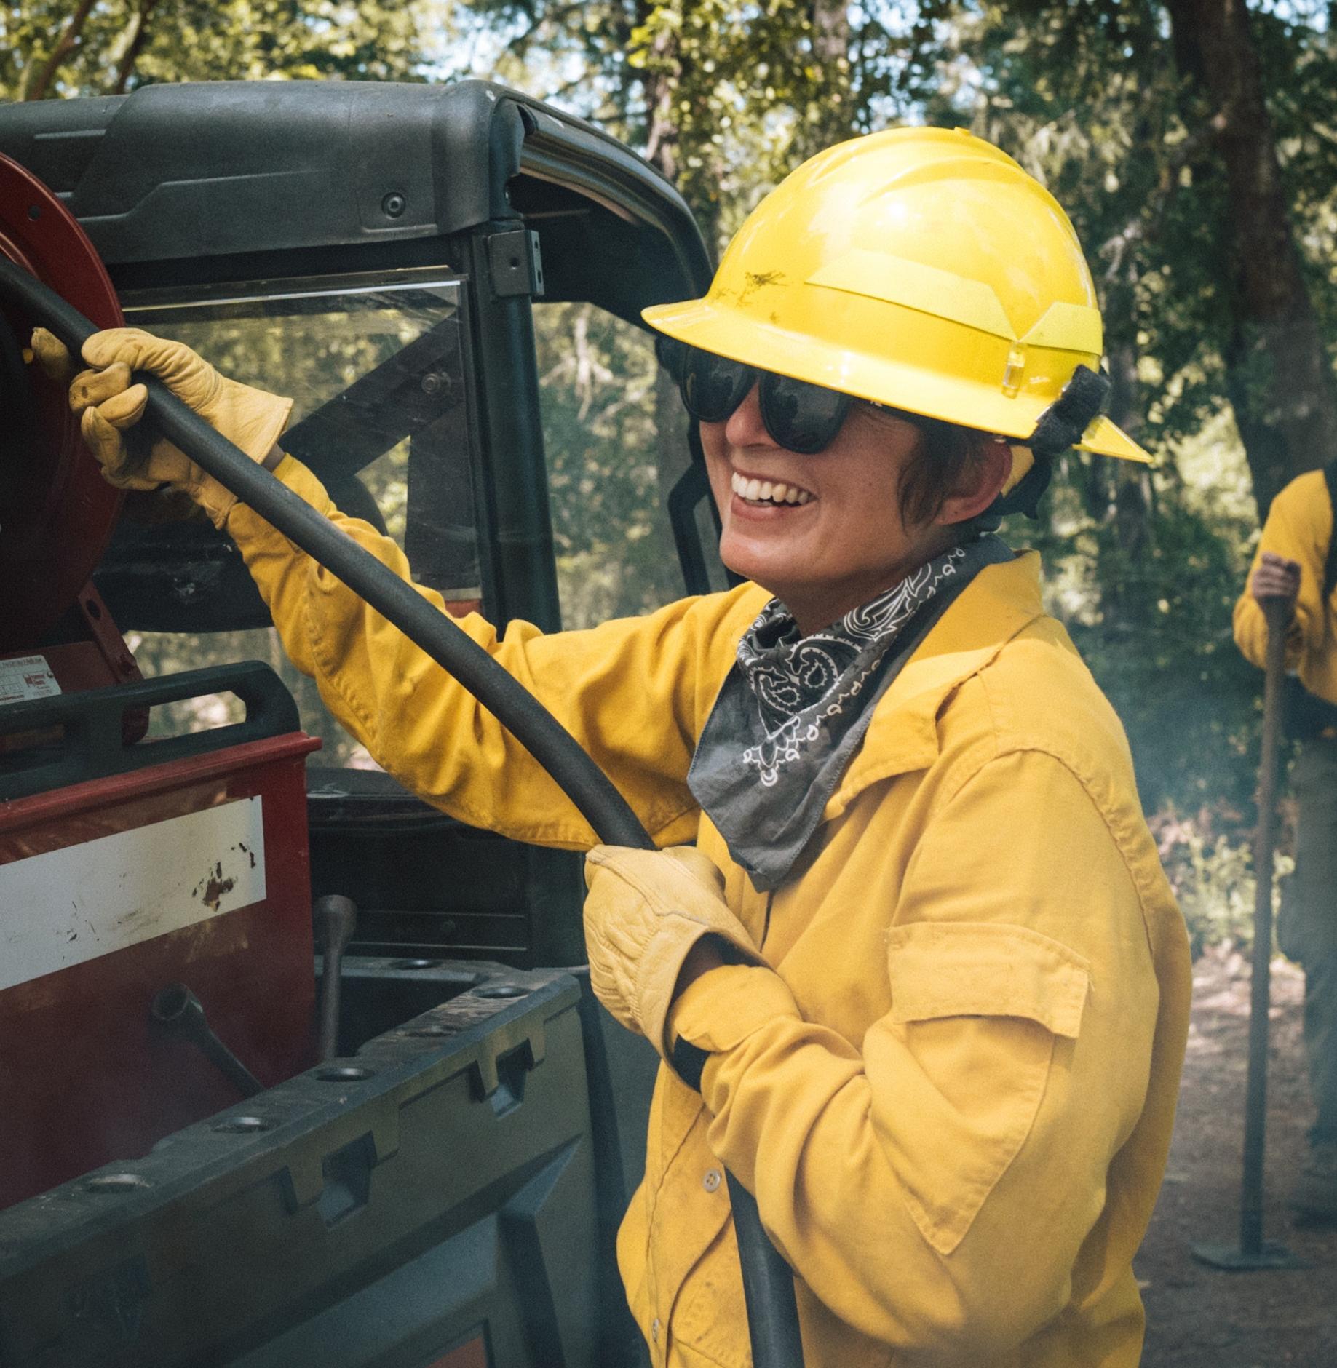
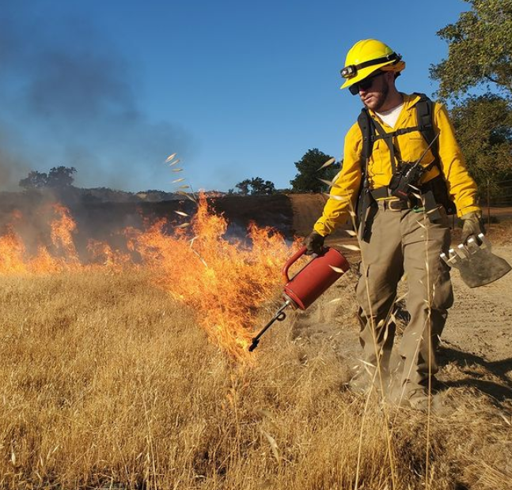
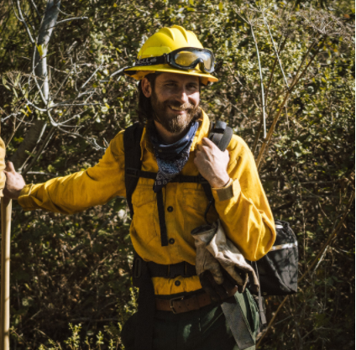
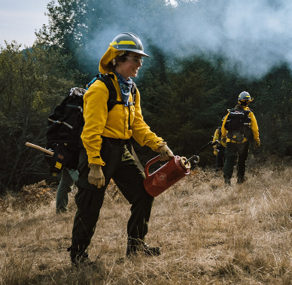
Prescribed Fire Fellows & Apprentices
photos by Sashwa Burrous

Slide 28
Critical Factors to Success
Community Collaborative Capacity Building
Essential to the success of vegetation management – must be a County and partner effort
Technical Advisory Committees:
Organizational Structure & Funding analysis, cost estimates & County coordination
Home-hardening, Defensible space (Home-Out)
Landscape-level vegetation management (Landscape-In) – ecological health, restoration and enhancement pared with wildfire resilience
Facilitate and enhance the efforts of Regional Collaborations
Workshops, technical advisors / community collaborators, experiential learning
Tree Mortality Task Force - to address threat of beetle kills in drought condition

Slide 29
County Timeline 2022-2023
Living with Fire: Sonoma County Forest Management Conference
FEMA – BRIC
Admin. Design and Coordination
FEMA – BRIC
Coordination Teams & Project Site Analysis
FEMA – BRIC
Env. Compliance / Outreach
FEMA – Haz. Fuel Mgt Coordination Team Launch
FEMA – Haz. Fuel Mgt District Site Selection Begins
FEMA – Haz. Fuel Mgt Env. Compliance
Haz. Fuel Mgt Bids and Contracting
2022 Veg Mgt Grant Implementation
2021-22 Veg Mgt Grant Monitoring
Veg Mgt Grant Program Reassessed
2023 Veg Mgt Grant Evaluation for Funding via CWPP
2023 Veg Mgt Grant Implementation
CWPP Revisions from 1st
Public Review
CWPP 2nd Draft
Public Review
CWPP Approval by BOS
CWPP Implementation Begins
WRP Phase 1: Model & software development
WRP training, testing and use by County programs;
revisions to model and tool
WRP proposed full release to public
July
2022
August
2022
September
2022
October
2022
November
2022
December 2022
January 2023
February 2023
March
2023
April
2023
May
2023

Slide 30
Questions & Comments
Please provide your comments or questions in the Q&A Panel.
Raise your hand the moderator will allow you to speak.

Slide 31
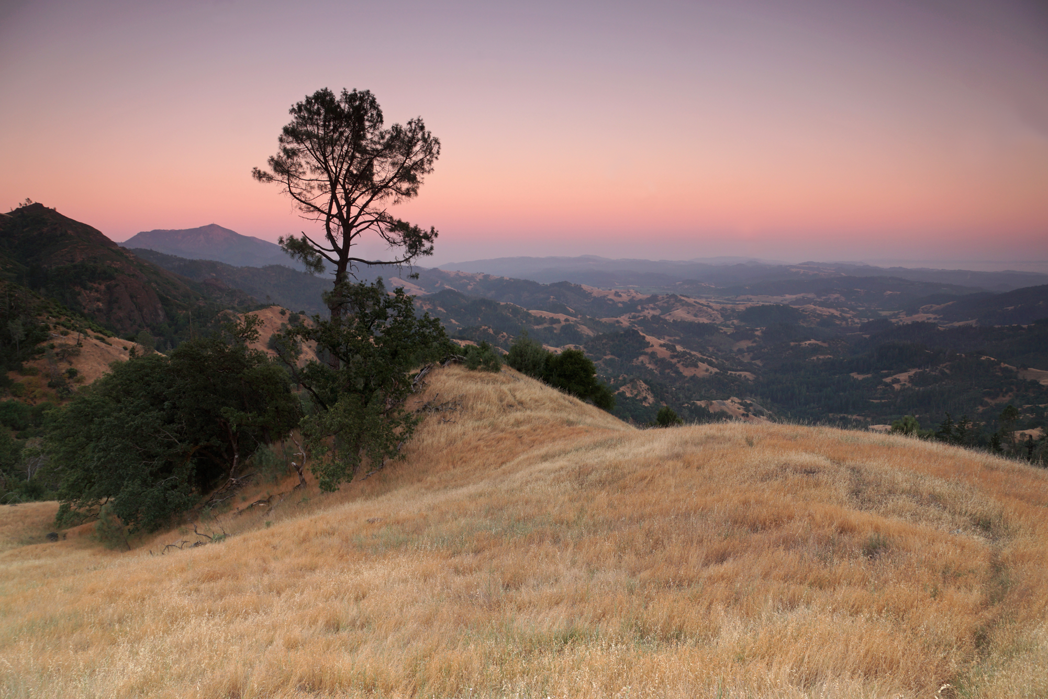
THANK YOU
Contact info: Kim.Batchelder@sonoma-county.org
Tel: (707) 565-7355

