Slide 1

Sonoma County Behavioral Health SUD Cal AIM – Problem List September 14th, 2022

Slide 2
Problem List: What is it?
A list of symptoms, conditions, diagnoses, and/or risk factors
Identified through assessment, psychiatric diagnostic evaluation, crisis encounters, or other types of service encounters
The problem list shall include, but is not limited to, the following:
Diagnoses identified by a provider acting within their scope of practice, if any.
Diagnosis-specific specifiers from the current DSM shall be included with the diagnosis, when applicable
Problems identified by a provider acting within their scope of practice, if any
Problems or illnesses identified by the beneficiary and/or significant support person, if any
The name and title of the provider that identified, added, or removed the problem, and the date the problem was identified, added, or removed
Problem list and progress note requirements shall support medical necessity
Can add more elements such as client and counselor initials (CP DAAC – Client Engagement)
Discussion: What do you think should be added or may be helpful to include on a list?

Slide 3
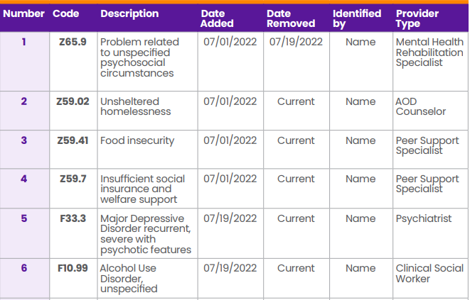
Problem List: Cal MHSA Example

Slide 4
Problem List: Other Examples
Copy of template being used by another county
Copy of template being used by Center Point DAAC

Slide 5
Problem List: SWITS
DHS is asking that providers keep both a paper and a SWITS problem list
The SWITS problem list is very basic and is a “miscellaneous notes” with selecting “problem list” note type
The content of the note can be edited and updated as the problem list changes

Slide 6
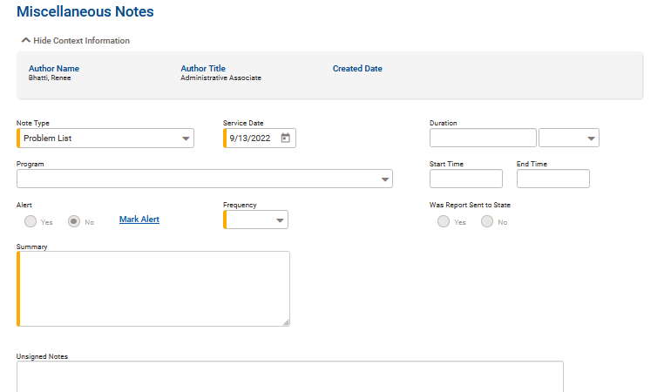
Problem List: SWITS

Slide 7
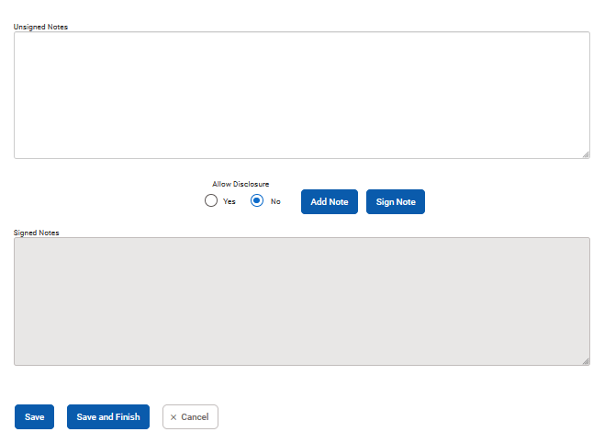
Problem List: SWITS

Slide 8
Problem List: NTPs
Problem List is addressed in BHIN 22-019
NTPs are NOT required to do Problem List
Narcotic Treatment Programs (NTP) are required by Federal law to create treatment plans for their beneficiaries. Furthermore, NTP requirements for documentation and program requirements are not changing under this BHIN.
NTP program physical exam requirements, timeframes, and documentation requirements are retained.
Sonoma County DHS is seeking guidance on ASAM and Telehealth for NTPs and responses are pending. Parts of BHIN 22-019 may still apply.

Slide 9
Problem List: When? / Who?
How often does the problem list get updated and by whom?
Wanted implemented 9/12/22, will be monitoring starting 9/30/22 (there is still time!)
The provider(s) responsible for the beneficiary’s care shall create and maintain a problem list
Updated on an ongoing basis to reflect the current presentation of the client
Updated “when there is a relevant change to a client’s condition” by adding or removing from the list
A problem identified during a service encounter (e.g., relapse) may be addressed by the service provider (within their scope of practice) during that service encounter, and subsequently added to the problem list
The problem does not need to be listed before addressing it
Providers shall update the problem list “within a reasonable time and in accordance with generally accepted standards of practice”

Slide 10
Problem List: Who Gives Input?
Based on previous slide pretty much anyone can have input right?
Licensed practitioners of the healing arts acting within scope of practice
Peers utilizing appropriate “Z codes”
Beneficiaries and their support persons
BUT LPHA Licensed Professional Clinical Counselor (LPCC) still to be determined for signing off on SUD diagnoses. Title 22 is not updated with LPCC and is in conflict with SPA noted below
Here is the SPA (state plan amendment) link – sincere apologies for not responding to your previous message! https://www.dhcs.ca.gov/Documents/CA-20-0006-A-Approval-Package.pdf
See the definition of LPHA on p. 11 of the PDF (labeled in the document as page 6, Supplement 3 to Attachment 3.1-A).

Slide 11
Problem List: Using Your List
While you have 30 (21+ years) to 60 ( < 21 or homeless) to complete the assessment a provisional diagnostic impression and ICD-10 code must be assigned
“other specified” ICD-10 codes (LPHA)
“unspecified” ICD-10 codes (LPHA)
“encounter for observation for other suspected diseases and conditions ruled out (LPHA)
“Z codes” Z55-Z65 for LPHA and Non LPHA (good for peer providers)
Z63.0 Problems in relationship with spouse or partner
Z59.0 Homelessness (.01 sheltered, .02 unsheltered)
Z56.0 Unemployment, unspecified
Update problem list as soon as a full assessment and diagnosis are completed
A provisional screening is fine for Level of Care during the assessment window, BUT a full ASAM must be completed during this window and still drives the LOC.
Update as soon as reasonably possible when changes to problem list, but a general guideline to fall within would be in alignment with progress notes and the 3 day standard
Utilization with Client in real time is the ideal, but not always possible. Examples!

Slide 12
The Brief Questionnaire for Initial Placement: BQuIP
DHS is reviewing BQuIP to screen for LOC in our system of care
UCLA developed and piloted (in Beta version – may be some changes)
DHCS approved to use for non-clinical staff who have completed BQuIP training
Objective is to get LOC recommendation right (matches full ASAM) > 80%
Screens for key risk categories: withdrawal, medical, mental, readiness for change, relapse, environment
Generates recommendations for critical issues, withdrawal management, additional services, and LOC recommendation
Takes about 10 minutes to complete but varies based on client presentation
The Brief Questionnaire for Initial Placement (uclaisap.org)

Slide 13
Problem List Wrap Up
Your concerns?
Your questions?
We will document your questions, concerns and send out a response, in writing, addressing each question
Rather than answering here – we want to be sure we consult with DHCS and DHS-BHD SUD Section staff, QA and Compliance, as needed. BHQA@sonoma-county.org

Slide 14
County Contacts
Melissa Struzzo, SUD section manager
Office: 707.565.4975 Melissa.Struzzo@sonoma-county.org
Chris Marlow, QAPI section manager
Cell: 707.490.4160
Christina.Marlow@sonoma-county.org
Will Gayowski, SUD QA manger
Cell: 707.321.9876
Will.Gayowski@sonoma-county.org
Cammie Noah, SUD QA manager
Office: 707-565.7472
Cammie.Noah@Sonoma-county.org

